Slide 1
Recurrent Neural Networks in Load Forecasting
Travis Whalen
September 8, 2020

Slide 2
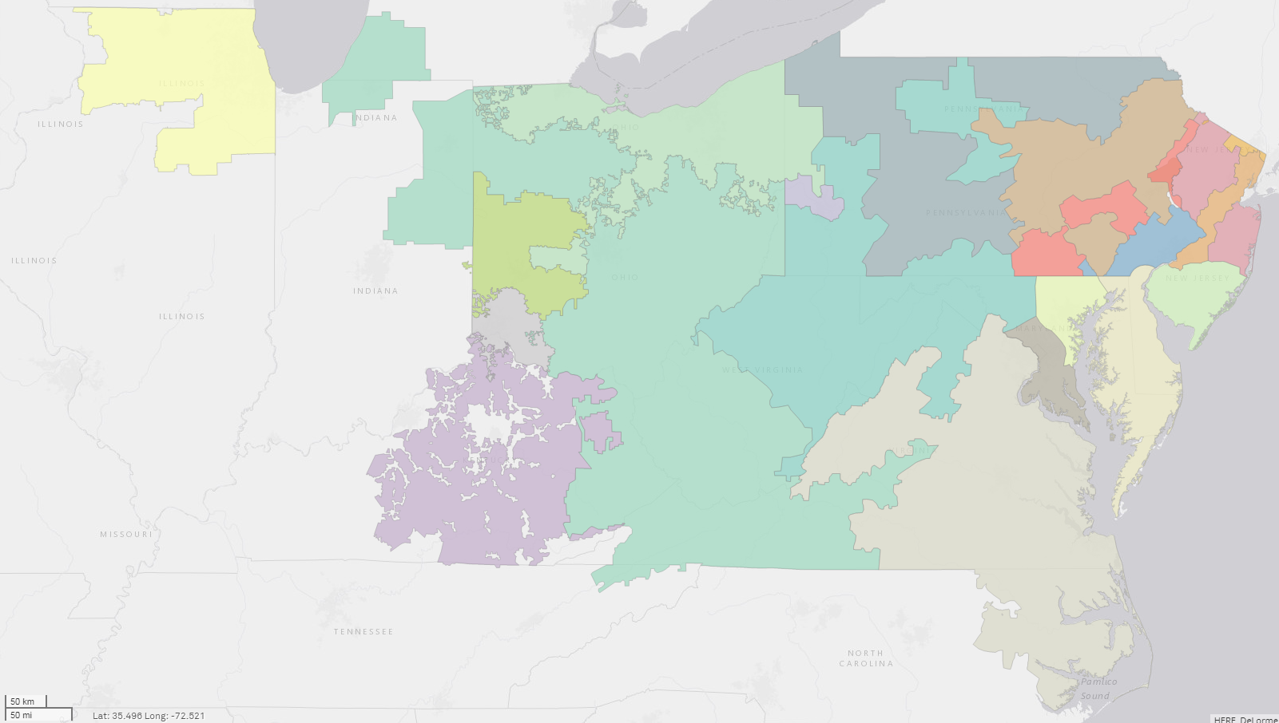
Problem Statement
Platts produces multiple reports based on estimates of electrical load, including backcasts that attempt to remove the effect of weather as well short-term forecasts. These estimates largely rely on conventional regression models with some form of regularization.
In particular, Platts released a new weekly forecast product covering total market trends in the PJM regional transmission organization, which estimates generation largely on the basis of forecast load.
In this project, I aimed to implement a more complex neural net model to determine whether the PJM load model could:
Significantly improve overall accuracy
Significantly improve peak hour accuracy
Retain short model runtimes to fit production timelines
COMED
AEP
ATSI
APS
AEP
DAY
DUQ
PENELEC
DEOK
APS
AEP
EKPC
DOM
Source: S&P Global Market Intelligence/Platts Analytics

Slide 3
Data Acquisition

Slide 4
Existing processes were tailored exclusively to product needs
Data acquisition centered around “ECA” – Exploratory Code Analysis
Extensive existing modeling and data processes
Current process (partially mapped to right):
42 python scripts
50+ functions
0 parameters
All necessary data ultimately available from existing processes
MASTER
DataPull
generation
price
load
GasPrice
Weather
dGeneration
gen_mapping
dLMP
PriceAPI
dLoad
LoadAPI
dGasPrice
dWeather
dSunlight_day
forecast_gen
trainpredict
nukeforecast
hydroforecast
solarforecast
otherforecast
windforecast
fossilforecast
capacity
weatherforecast
PlattsForecast
Installed Capacity.xlsx
fWeather
fSunlight
LoadModel
LoadModel_backup
InterchangeAPI
LoadForecastAPI
LoadForecastHistAPI

Slide 5
Data concerns significantly limit timeframe for model validation
Source: PJM, Platts Analytics

Slide 6
Modeling

Slide 7
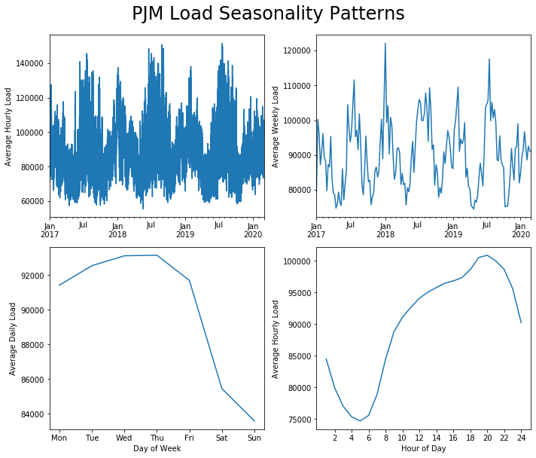
Multiple forms of seasonality represent main challenge in modeling load
Electric load entails data that fundamentally violates assumptions for both conventional OLS regressions (time series) and autoregressive models (seasonality)
Multiple forms of seasonality limit efficacy of normalization tools:
Seasonal weather changes
Weather-related changes in demand sources (i.e. heating vs cooling)
Weekdays versus weekend
Daily temperature changes
Source: PJM, Platts Analytics

Slide 8
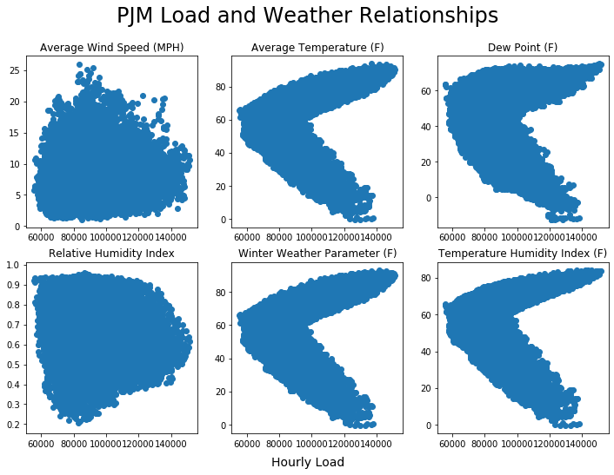
Current LASSO models incorporate seasonality, weather relationships, and lagged load
Multiple existing LASSO models include:
Season, month, day of week and hour
Load values lagged by 24, 48, or 168 hours
Two alternate sets of weather data:
Daily high and low temperature
Hourly average temperature, average wind speed, dew point, and relative humidity
Interaction effects for all data and square terms for all lag and weather data
Adapted the more granular weather data, including logic for the “winter weather parameter” and “temperature humidity index”
Source: NCEI, PJM, Platts Analytics

Slide 9

Large geographic footprint limits accuracy of single model, but granular weather data not yet aggregated on regional level
Source: NASA Worldview/Platts Analytics

Slide 10
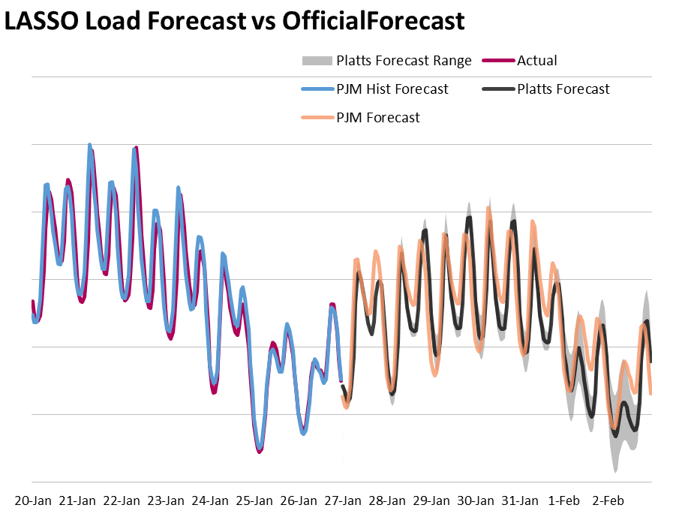
Validation processes require for both new and existing model
Limited metrics on accuracy of current models
No existing backtesting procedures
Available evidence indicates high degree of accuracy in near-term backcasts/forecasts
Runtimes currently around 1-2 minutes for load model
Source: PJM, Platts Analytics

Slide 11
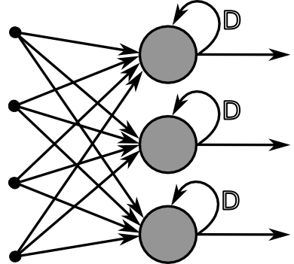
Recurrent neural networks already see use predicting load
Multiple papers have investigated use of recurrent neural nets (RNN) in load modeling
All papers investigated for this project used long short-term memory (LSTM) RNNs
Most papers focused on extremely short-term load forecasting (e.g. sub-hourly to day-ahead)
Many papers relied upon pre-trained models provided new sets of load data
This project hoped to use a newer and generally faster gated recurrent unit (GRU) model to enable regular retraining
Source: Wikimedia Commons

Slide 12
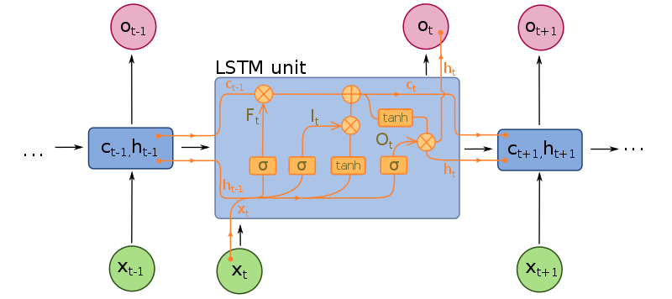
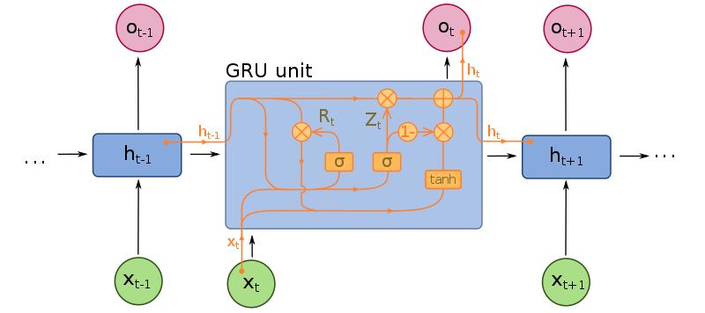
LSTM vs GRU – GRUs’ reduced complexity typically results in lower training time, but risk ignoring longer-term relationships

Slide 13
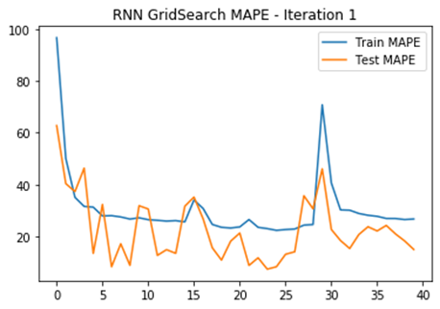
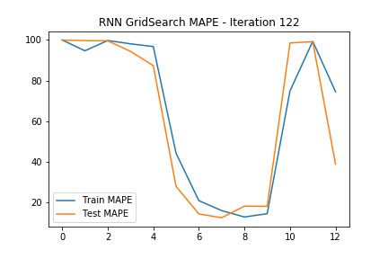
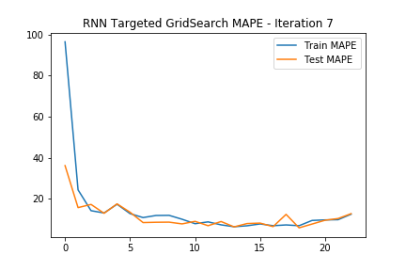
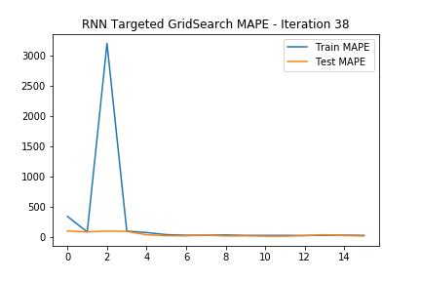
Pitfalls and time constraints limit RNN implementation
RNNs appear not to be fully integrated with grid search tools for parameter selection
Manual grid search allowed more complete parameter testing
Model training time restrictions ruled out several slower-running parameter options (e.g. recursions in excess of 48 hours)
Misapplication of random seed for NNs limited validity of initial grid search results
High variance in response to random seeds required implementation of ensemble forecasts within grid search

Slide 14
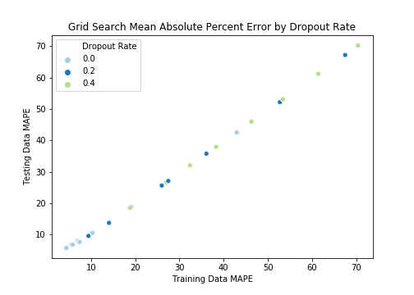
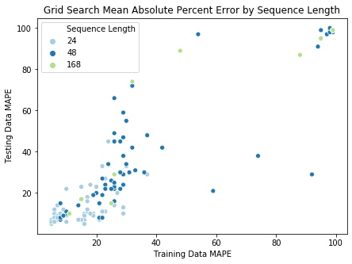
Methodological errors led to notable disparities between training and testing error rates in early runs

Slide 15
Grid search ran more than 400 models including ensembles
Initial Parameters Tested
Sequence Length (Recursion Depth): 24, 48, 168
Mini Batch Size: 256, 512
Hidden Layers: 2, 3, 4 (Limited Early Tests)
Neurons Per Layer:
64, 128
32, 64
16, 32
8, 16
Dropout Rate: 0, 0.2
Secondary Parameters Tested
Sequence Length: 12, 24
Dropout Rate: 0, 0.2, 0.4
Early Stopping Patience: 3, 4
Optimizer Learning Rate: 0.001, 0.01
Epochs: 40, 80
Final Parameters
Sequence Length: 12
Mini Batch Size: 256
Hidden Layers: 4
Neurons Per Layer:
128
32
16
16
Dropout Rate: 0
Early Stopping Patience: 4
Optimizer Learning Rate: 0.01
Epochs: 40
Training Data Length: 17520 hours
Training Data Length: 720 hours

Slide 16
Results

Slide 17
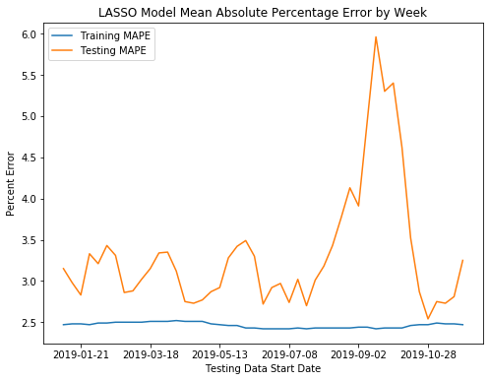
New validation process supports strong performance of LASSO
Validation Process
Moving two-year window (17520 hours)
Tested against subsequent month (720 hours)
Model run on a weekly basis for 47 weeks
LASSO Results:
MAPE | Training Data | Testing Data
Minimum | 2.42 | 2.54
Average | 2.46 | 3.33
Maximum | 2.52 | 5.96
Std. Deviation | 0.03 | 0.76

Slide 18
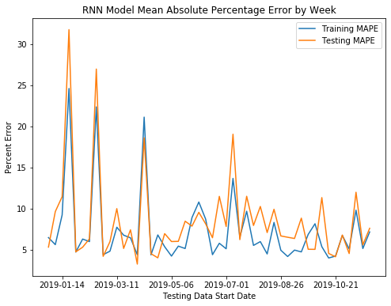
RNN sees significant volatility in validation process
Validation Process
Five-iteration ensemble
Moving two-year window (17520 hours)
Tested against subsequent month (720 hours)
Model run on a weekly basis for 47 weeks
RNN Results:
MAPE | Training Data | Testing Data
Minimum | 4.00 | 3.26
Average | 7.33 | 8.55
Maximum | 24.6 | 31.75
Std. Deviation | 4.49 | 5.49

Slide 19
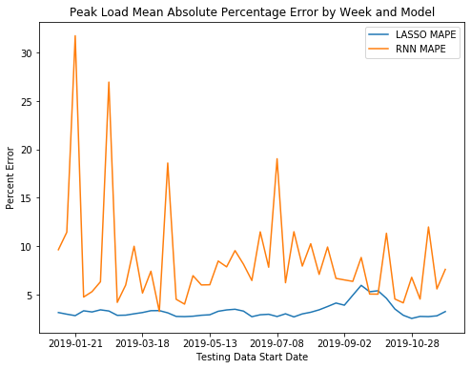
Conclusions
Given its high volatility and comparatively low accuracy, the initial approach seems unlikely to result in a model capable of challenging the LASSO.
Neural nets can be prone to volatility, but the extremity of week-to-week movements could indicate further methodological errors.
Temperature square term mistakenly excluded from training set, with significant potential impact.
Volatility could also indicate the need for larger ensembles, which would likely violate the stated need for rapid training. This could be mitigated by relying on a pre-trained model updated less frequently.

Slide 20
Next Steps
It would likely worth re-running the larger grid searches with corrected methodology and the inclusion of some additional interaction and power terms that had been excluded initially.
The requirement to train the model on a weekly basis is largely intended to simplify processes, but creating a pre-trained model could prove preferable assuming improved accuracy.
While LSTMs are slower to train, they could be worth revisiting in the event that a pre-trained model proves viable.
Some power and interaction terms within the LASSO appear to be implemented incorrectly, which could be limiting its accuracy, potentially raising the baseline required for an RNN to beat.

Slide 21
Innovative market insights
Driven by analytics, powered by fundamentals

Slide 22

Q&A

